Slide 1
Learning with differentiable and amortized optimization
Brandon Amos • Meta AI (FAIR) NYC
http://github.com/bamos/presentations

Slide 2
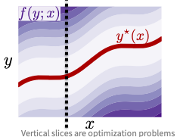




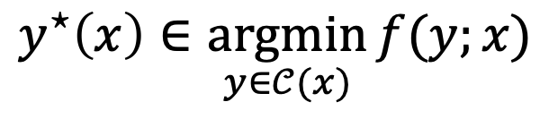
Optimization is crucial technology
Optimization is a modeling and decision-making paradigm and encodes reasoning operations
Finds the best way to interact with a representation of the world
Focus: parametric optimization problems that are repeatedly solved
optimal solution
objective
context (or parameterization)
$$y^{⋆}\left(x\right)∈\underset{y∈𝒞(x)}{argmin}{f(y;x)}$$
optimization variable
constraints

Slide 3
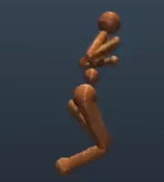
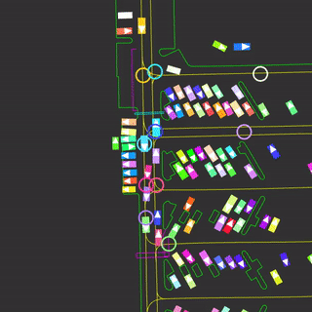
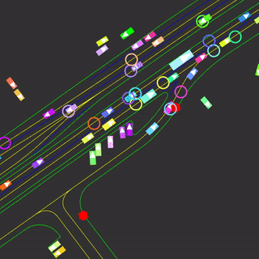
Breakthroughs enabled by optimization include
​controlling systems (robotic, autonomous, mechanical, and multi-agent)
​​making operational decisions based on future predictions
efficiently transporting or matching resources, information, and measures for optimal transport and generative modeling
​​​allocating budgets and portfolios,
​designing materials, molecules, and other structures,
​solving inverse problems (infers underlying hidden costs, incentives, geometries, terrains, and other structures)
​parameter learning of predictive and statistical models
optimal solution
objective
context (or parameterization)
$$y^{⋆}\left(x\right)∈\underset{y∈𝒞(x)}{argmin}{f(y;x)}$$
optimization variable
constraints

Slide 4
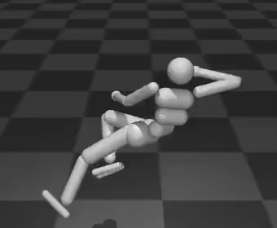
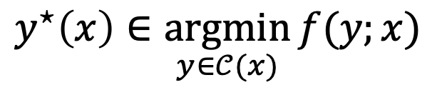
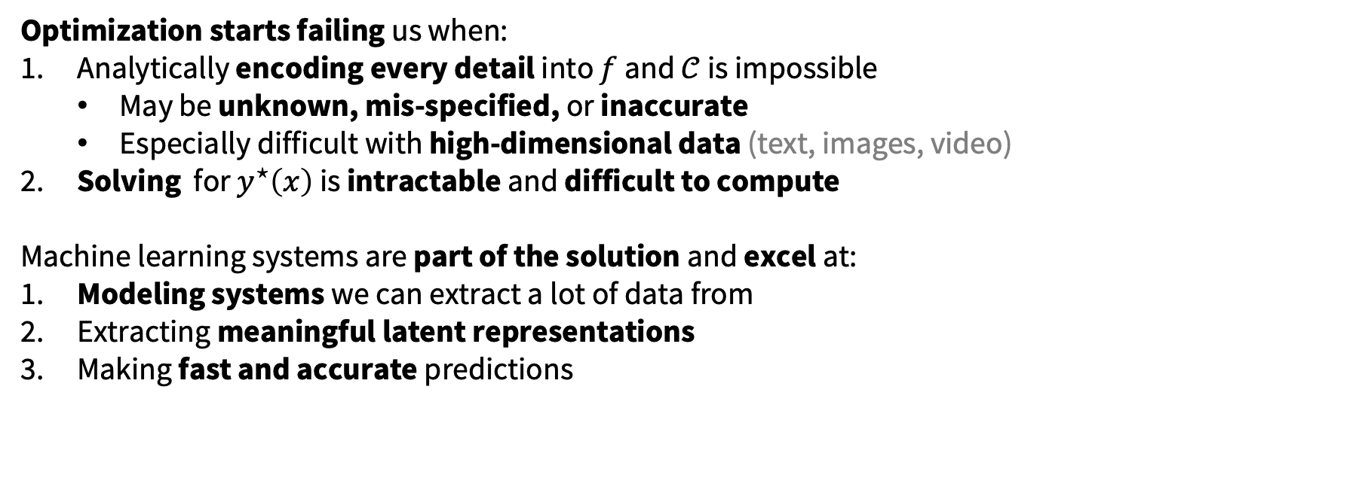
When optimization fails, machine learning helps
$$y^{⋆}\left(x\right)∈\underset{y∈𝒞(x)}{argmin}{f(y;x)}$$
Optimization starts failing us when:
Analytically encoding every detail into $f$ and $𝒞$ is impossible
May be unknown, mis-specified, or inaccurate
Especially difficult with high-dimensional data (text, images, video)
​Solving for $y^{⋆}\left(x\right)$ is intractable and difficult to compute
Machine learning systems are part of the solution and excel at:
​​​Modeling systems we can extract a lot of data from
Extracting meaningful latent representations
Making fast and accurate predictions

Slide 5
When machine learning fails, optimization helps
When optimization fails, machine learning helps
A lot of data
Model
Predictions
Loss
AI/AGI: A pile of linear algebra?
Is a black-box of linear algebra the solution to AI/AGI? Maybe…
Without enough data, learning systems struggle to:
​​​Encode hard constraints and rules of the world crucial for safety
Perform reasoning operations
Isolate interpretable and modular subcomponents
​​​Generalize to new settings beyond the training distribution
Optimization often excels in these and can be brought into the model/loss

Slide 6
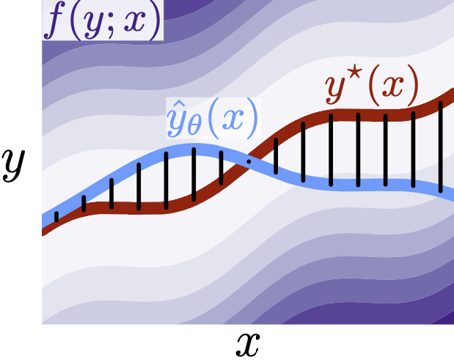
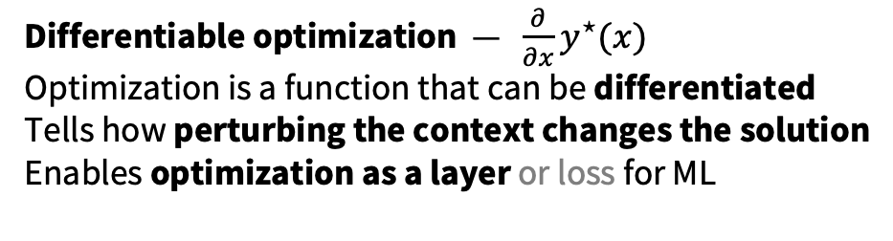
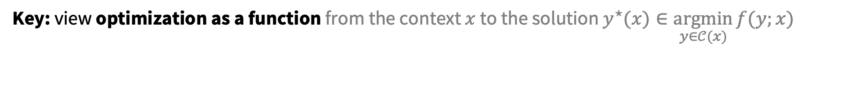
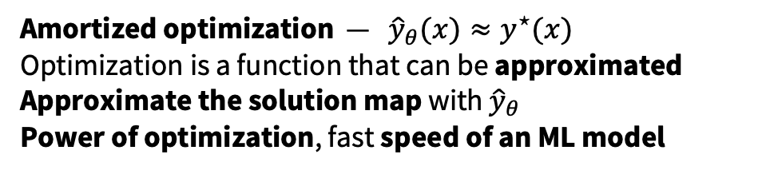
Integrating optimization and machine learning
Key: view optimization as a function from the context $x$ to the solution $y^{⋆}(x)∈\underset{y∈𝒞(x)}{argmin}{f(y;x)}$
Differentiable optimization — $\frac{∂}{∂x}y^{⋆}(x)$
Optimization is a function that can be differentiated
Tells how perturbing the context changes the solution
Enables optimization as a layer or loss for ML
Amortized optimization — ${\hat{y}}_{θ}(x)≈y^{⋆}(x)$
Optimization is a function that can be approximated
Approximate the solution map with ${\hat{y}}_{θ}$
Power of optimization, fast speed of an ML model
Vertical slices are optimization problems

Slide 7
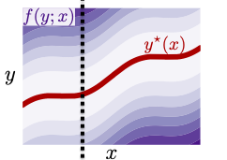
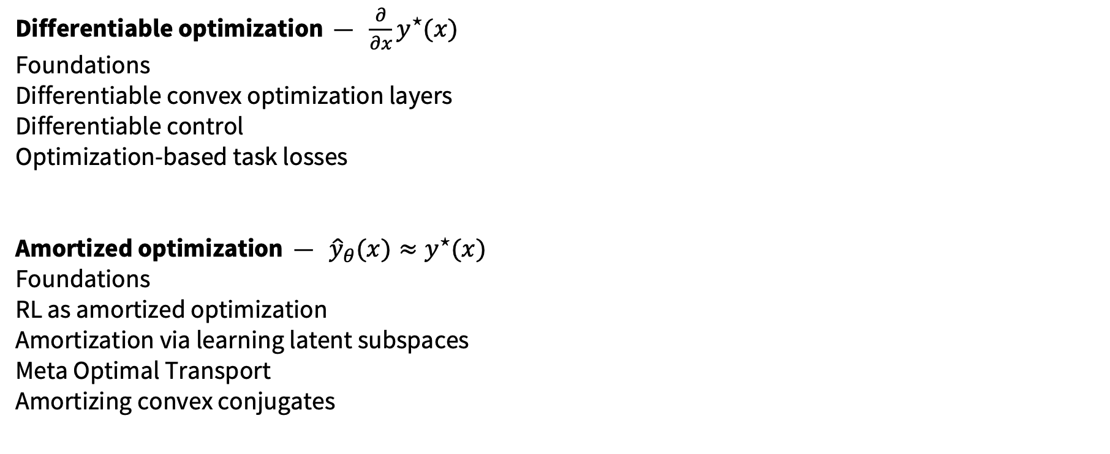
This talk
Differentiable optimization — $\frac{∂}{∂x}y^{⋆}(x)$
Foundations
Differentiable convex optimization layers
Differentiable control
Optimization-based task losses
Amortized optimization — ${\hat{y}}_{θ}(x)≈y^{⋆}(x)$
Foundations
RL as amortized optimization
Amortization via learning latent subspaces
Meta Optimal Transport
Amortizing convex conjugates

Slide 8
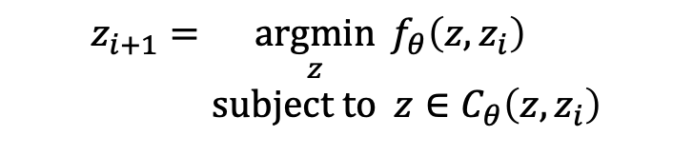
Differentiable optimization layers
Definition. A differentiable optimization layer for a machine learning model internally solves an optimization problem and is learned with backpropagation
Why optimization? Many useful operations can be expressed with optimization (sorting, permutations, top-k, control, planning, power generation, and others from earlier)
Why differentiable optimization? End-to-end learn through the optimization procedure along with the other parts of the model using derivatives
A lot of data
Model
Predictions
Loss
…
Optimization Layer
…
$$z_{i+1}=\underset{z}{argmin}{f_{θ}\left(z, z_{i}\right)} \\ subject to z∈C_{θ}\left(z, z_{i}\right)$$

Slide 9
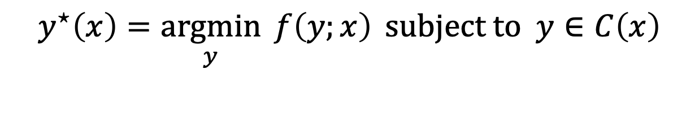
Differentiable convex optimization layers
The argmin of a convex optimization problem is non-convex and expressive
Most models already use differentiable convex optimization layers!* *Useful as an introduction for differentiable convex optimization, not for improving these models
Standard non-linearities to be seen as solutions to convex optimization problem (ReLU, sigmoid, softmax)
$$y^{⋆}\left(x\right)=\underset{y}{argmin}{f\left(y;x\right)} subject to y∈C\left(x\right)$$

Slide 10
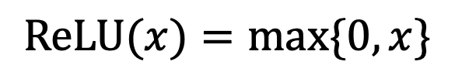
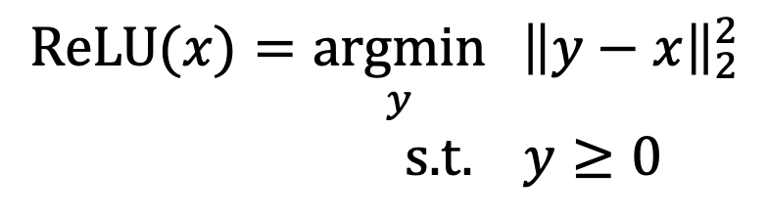
The ReLU is a convex optimization layer
Section 2 of Differentiable optimization-based modeling for machine learning. Amos, PhD Thesis 2019
Proof: Comes from first-order optimality
$$\text{ReLU}(x)=\max{\{0, x\}}$$
$$\text{ReLU}(x)=\underset{y}{argmin}{ {\left\|y−x\right\|}_{2}^{2}} \\ \text{s}\text{.}\text{t}\text{. } y≥0$$

Slide 11
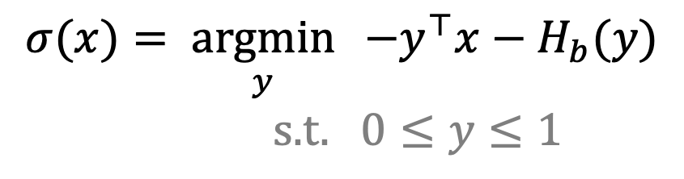
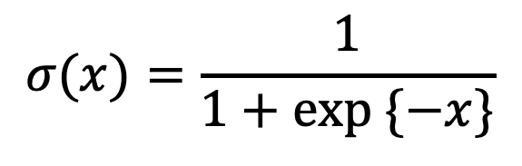
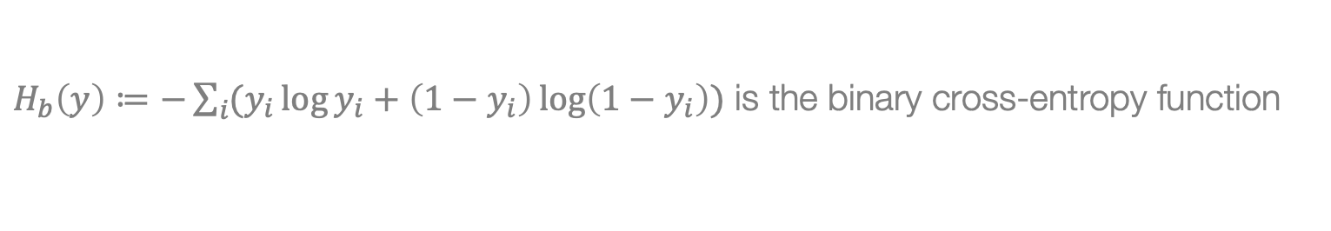
The sigmoid is a convex optimization layer
Section 2 of Differentiable optimization-based modeling for machine learning. Amos, PhD Thesis 2019
Proof: Comes from first-order optimality
$$σ(x)=\frac{1}{1+exp \{−x\}}$$
$$σ(x)=\underset{y}{argmin}{ −y^{⊤}x−H_{b}(y)} \\ \text{s}\text{.}\text{t}\text{. }0≤y≤1$$
$H_{b}\left(y\right)≔−\sum_{i}{(y_{i}\log{y_{i}}+\left(1−y_{i}\right)\log\left(1−y_{i}\right))}$ is the binary cross-entropy function

Slide 12
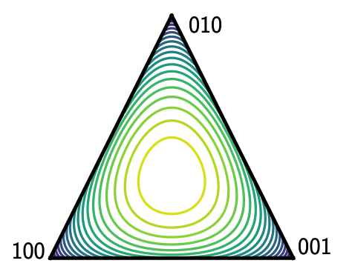
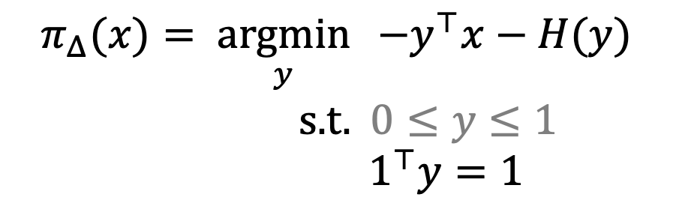
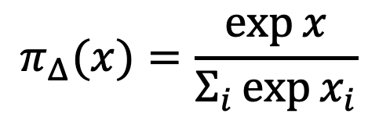
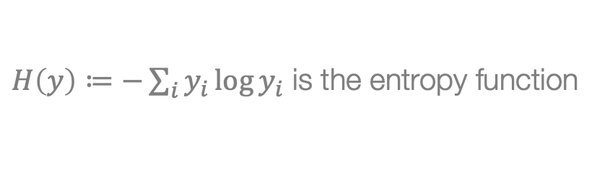
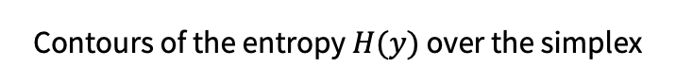
The softargmax is a convex optimization layer
Section 2 of Differentiable optimization-based modeling for machine learning. Amos, PhD Thesis 2019
Proof: Comes from first-order optimality
$$π_{Δ}(x)=\frac{\exp{x}}{Σ_{i}\exp{x_{i}}}$$
$$π_{Δ}(x)=\underset{y}{argmin}{ −y^{⊤}x−H(y)} \\ \text{s}\text{.}\text{t}\text{.} 0≤y≤1$$
$${ 1}^{⊤}y=1$$
Contours of the entropy $H(y)$ over the simplex
$H\left(y\right)≔−\sum_{i}{y_{i}\log{y_{i}}}$ is the entropy function

Slide 13
How can we generalize this?
A lot of data
Model
Predictions
Loss
…
Optimization Layer
…
$$z_{i+1}=\underset{z}{argmin}{f_{θ}\left(z, z_{i}\right)} \\ subject to z∈C_{θ}\left(z, z_{i}\right)$$
Derivatives and backpropagation
For learning, we differentiate or backpropagate through these layers — differentiable optimization
Easy if the optimization problem has an explicit, closed-form solution (often standard differentiation)
Otherwise, need to use implicit differentiation, which is also used for sensitivity analysis

Slide 14
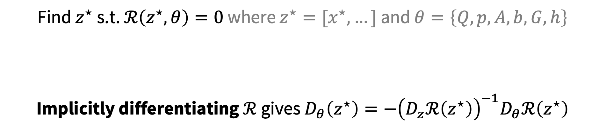
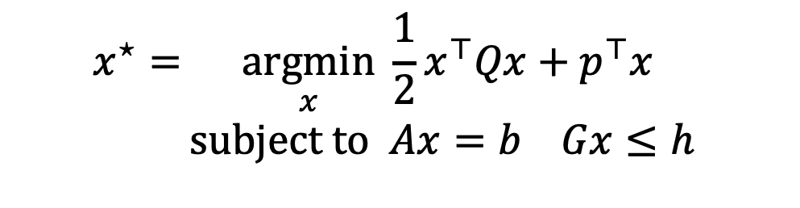
Differentiable convex quadratic programs
OptNet: Differentiable Optimization as a Layer in Neural Networks. Amos and Kolter, ICML 2017.
$$x^{⋆}=\underset{x}{argmin}{\frac{1}{2}x^{⊤}Qx+p^{⊤}x} \\ subject to Ax=b Gx≤h$$
KKT Optimality
Find $z^{⋆}$ s.t. $ℛ\left(z^{⋆}, θ\right)=0$ where $z^{⋆}=[x^{⋆},…]$ and $θ=\left\{Q,p,A,b,G,h\right\}$
Implicitly differentiating $ℛ$ gives $D_{θ}\left(z^{⋆}\right)=−{\left(D_{z}ℛ\left(z^{⋆}\right)\right)}^{−1}D_{θ}ℛ\left(z^{⋆}\right)$

Slide 15
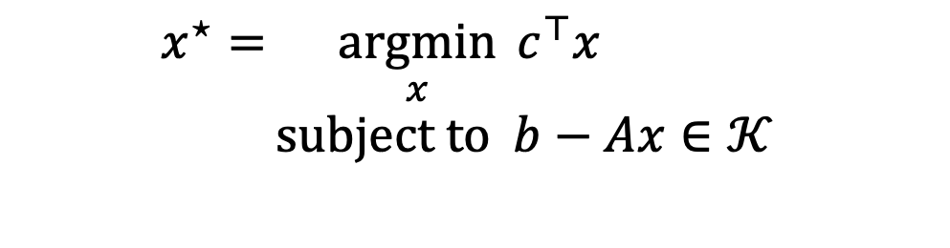
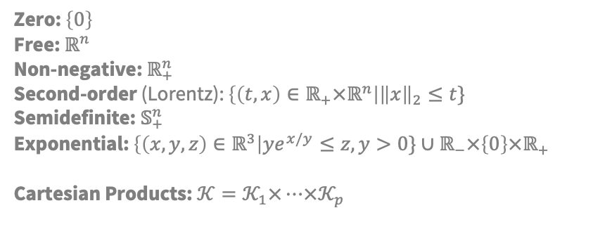
Differentiable convex conic programs
Section 7 of Differentiable optimization-based modeling for machine learning. Amos, PhD Thesis 2019
Differentiating through a cone program. Agrawal et al., 2019 Differentiable convex optimization layers. Agrawal*, Amos*, Barratt*, Boyd*, Diamond*, Kolter*, NeurIPS 2019.
$$x^{⋆}=\underset{x}{argmin}{c^{⊤}x} \\ subject to b−Ax∈𝒦$$
Zero: $\left\{0\right\}$ Free: $ℝ^{n}$ Non-negative: $ℝ_{+}^{n}$ Second-order (Lorentz): $\left\{\left(t,x\right)∈ℝ_{+}×ℝ^{n}\right|{\left\|x\right\|}_{2}≤t\}$ Semidefinite: $𝕊_{+}^{n}$ Exponential: $\left\{\left(x,y,z\right)∈ℝ^{3}\right|ye^{x/y}≤z, y>0\}∪ℝ_{−}×\left\{0\right\}×ℝ_{+}$ Cartesian Products: $𝒦=𝒦_{1}×…×𝒦_{p}$
Conic Optimality
Find $z^{⋆}$ s.t. $ℛ\left(z^{⋆}, θ\right)=0$ where $z^{⋆}=[x^{⋆},…]$ and $θ=\{A,b,c\}$
Implicitly differentiating $ℛ$ gives $D_{θ}\left(z^{⋆}\right)=−{\left(D_{z}ℛ\left(z^{⋆}\right)\right)}^{−1}D_{θ}ℛ\left(z^{⋆}\right)$

Slide 16
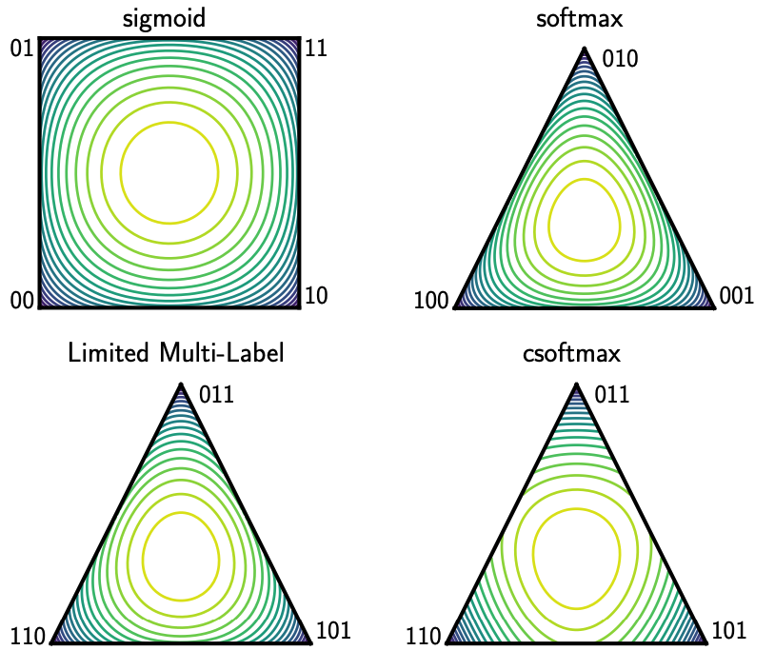
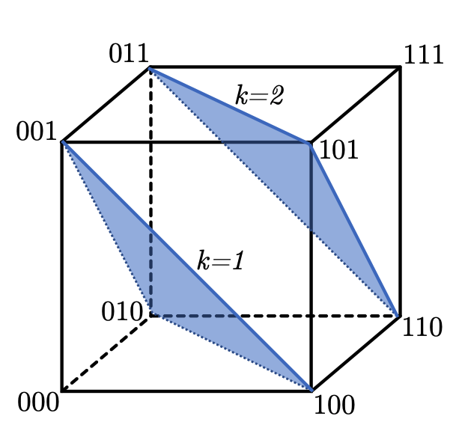
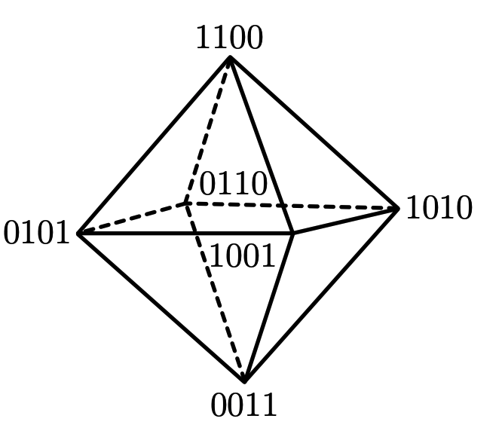
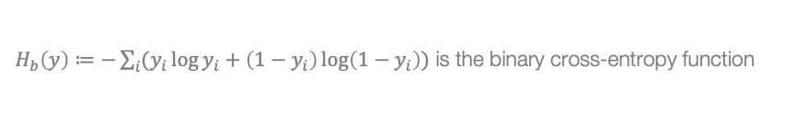
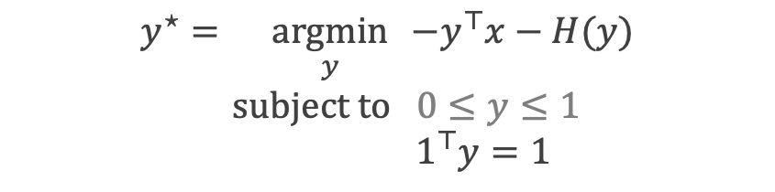
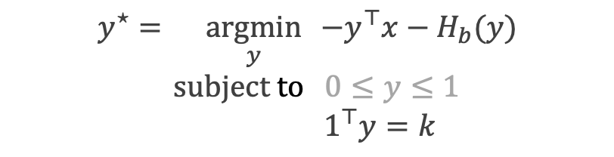
From the softmax to soft and differentiable top-k
Limited multi-label projection layer. Amos et al., 2019.
$$y^{⋆}=\underset{y}{argmin}{ −y^{⊤}x−H(y)} \\ \text{subject} \text{to} 0≤y≤1$$
$$1^{⊤}y=1$$
$$y^{⋆}=\underset{y}{argmin}{ −y^{⊤}x−H_{b}(y)} \\ \text{subject} \text{to} 0≤y≤1$$
$$1^{⊤}y=k$$
$H_{b}\left(y\right)≔−\sum_{i}{(y_{i}\log{y_{i}}+\left(1−y_{i}\right)\log\left(1−y_{i}\right))}$ is the binary cross-entropy function
Contours of the entropy penalties

Slide 17
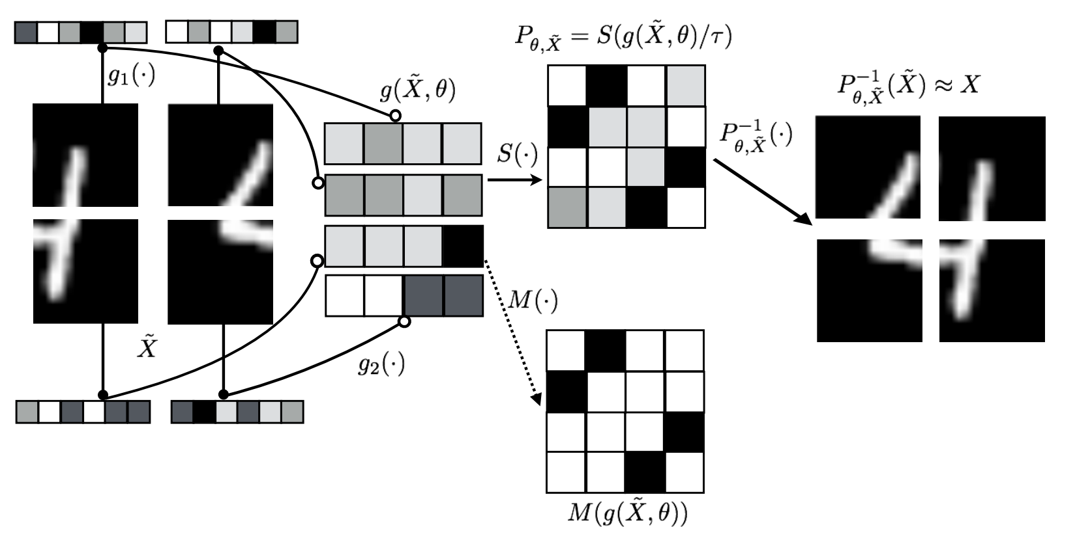
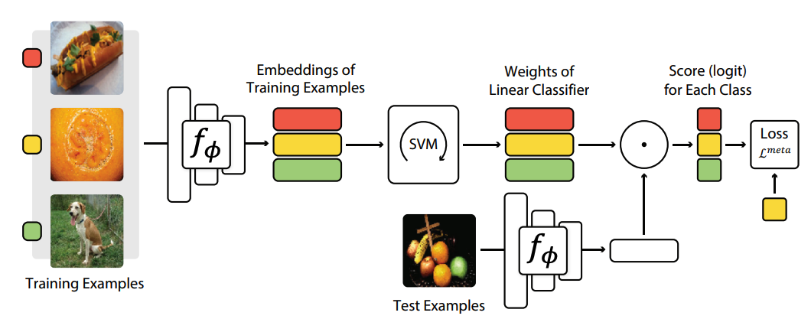

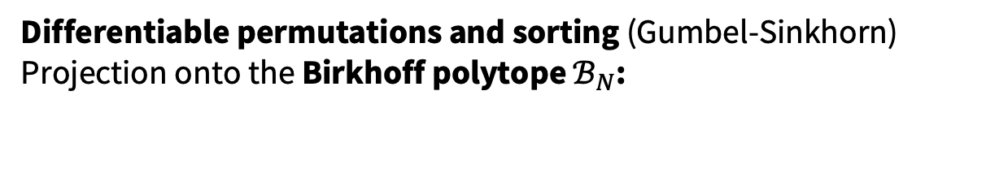
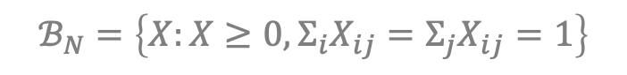
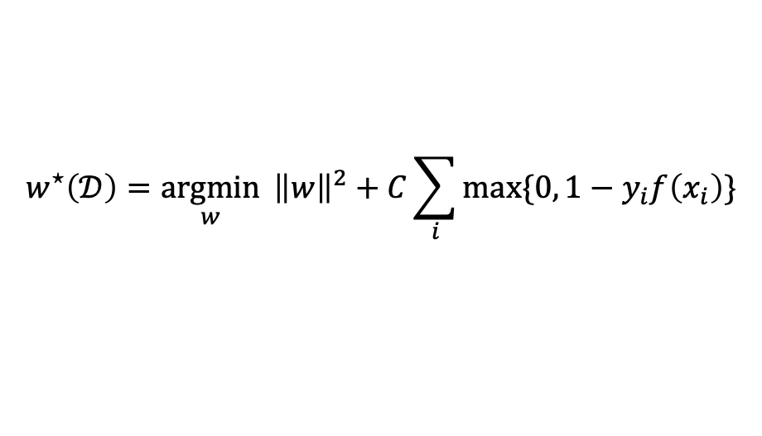
Differentiable permutations, sorting and SVMs
Differentiable permutations and sorting (Gumbel-Sinkhorn) Projection onto the Birkhoff polytope $ℬ_{N}$:
$$S\left(\frac{X}{τ}\right)=\underset{P∈ℬ_{N}}{argmax}{{ \left\langle P, X\right\rangle }_{F}+τH\left(P\right)}$$
$$ℬ_{N}=\left\{X:X≥0, Σ_{i}X_{ij}=Σ_{j}X_{ij}=1\right\}$$
Learning latent permutations with Gumbel-Sinkhorn networks. Mena et al., ICLR 2018.
Differentiable SVMs (MetaOptNet) Differentiate the decision boundary w.r.t. the dataset
$$w^{⋆}\left(𝒟\right)={\underset{w}{argmin}{ \left\|w\right\|}}^{2}+C\sum_{i}{\max{\{0, 1−y_{i}f\left(x_{i}\right)\}}}$$
Meta-learning with differentiable convex optimization. Lee et al., CVPR 2019.

Slide 18
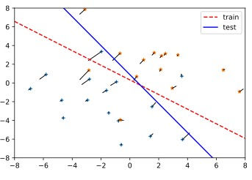
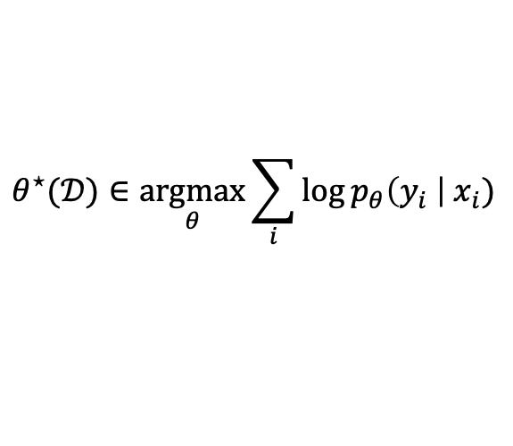
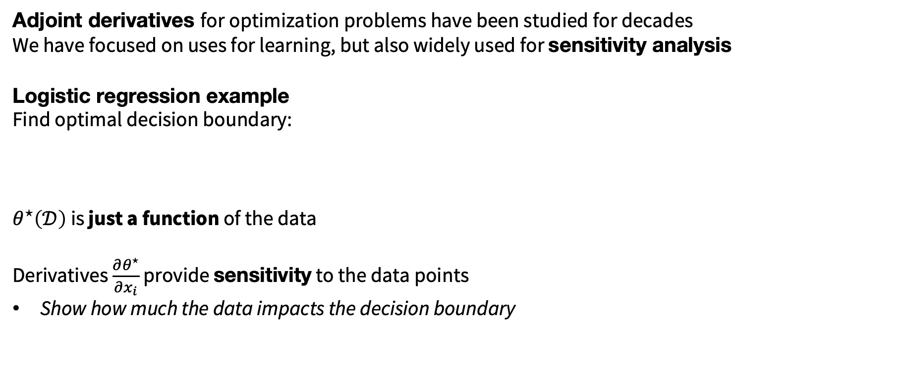
Sensitivity and perturbation analysis
Differentiable convex optimization layers. Agrawal*, Amos*, Barratt*, Boyd*, Diamond*, Kolter*, NeurIPS 2019.
Adjoint derivatives for optimization problems have been studied for decades
We have focused on uses for learning, but also widely used for sensitivity analysis
Logistic regression example
Find optimal decision boundary:
$θ^{⋆}\left(𝒟\right)$ is just a function of the data
Derivatives $\frac{∂θ^{⋆}}{∂x_{i}}$ provide sensitivity to the data points
Show how much the data impacts the decision boundary
$$θ^{⋆}(𝒟)∈\underset{θ}{argmax}{\sum_{i}{\log{p_{θ}\left(y_{i} \right|{ x}_{i})}}}$$

Slide 19
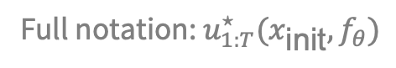
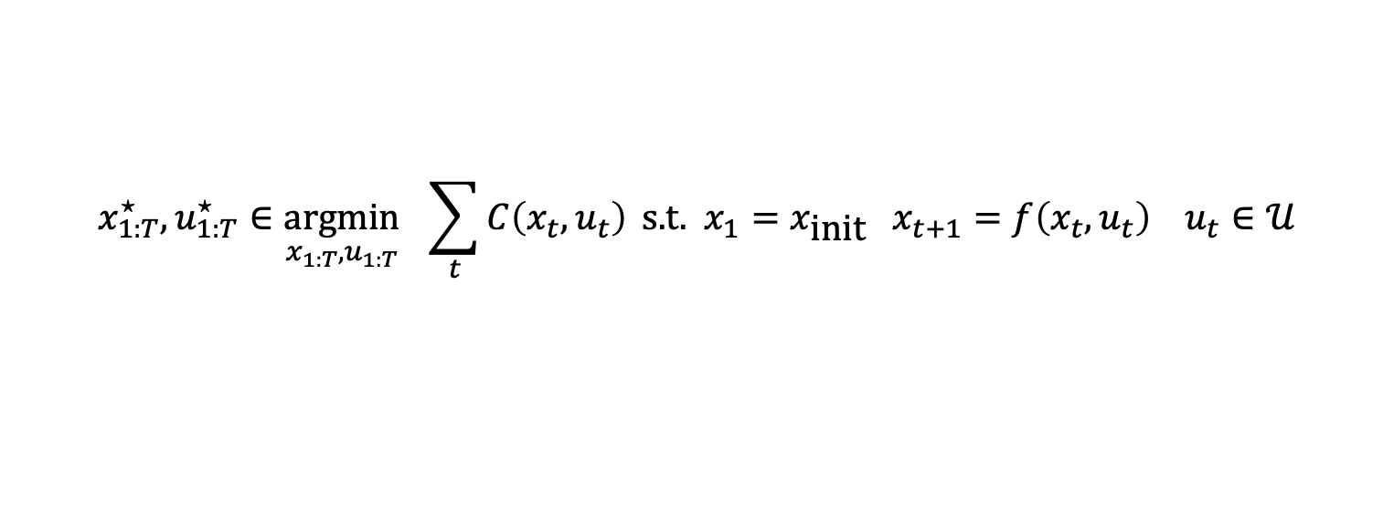
Optimal control drives systems
Setting: deterministic, discrete-time system with a continuous state-action space
Widely deployed over the past century in aviation, robotics, vehicles, HVAC
Often for a Markov decision process but doesn’t have to be
The real-world is non-convex, so are our controllers
Convex in some cases, e.g., with quadratic cost/linear dynamics (LQR)
No learning necessary if we know the system — just pure optimization
cost
initial state
dynamics
constraints
$${x_{1:T}^{⋆}, u}_{1:T}^{⋆}∈\underset{{x_{1:T}, u}_{1:T}}{argmin}{ \sum_{t}{C\left(x_{t}, u_{t}\right)}} \text{s}\text{.}\text{t}\text{. }x_{1}=x_{\text{init}} x_{t+1}=f\left(x_{t}, u_{t}\right) u_{t}∈𝒰$$
Full notation: $u_{1:T}^{⋆}(x_{\text{init}}, f_{θ})$
On the model-based stochastic value gradient for continuous reinforcement. B. Amos et al., L4DC 2021
Nocturne: a driving benchmark for multi-agent learning. E. Vinitsky et al., NeurIPS Datasets and Benchmarks 2022

Slide 20
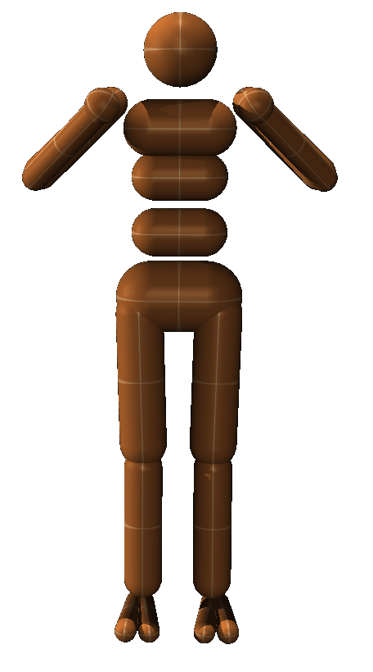
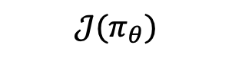
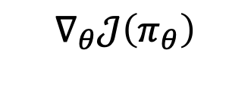
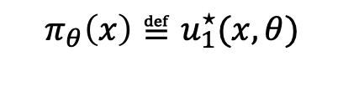




Differentiable control
Differentiable MPC for end-to-end planning and control. Amos et al., NeurIPS 2018. The differentiable cross-entropy method. Amos and Yarats, ICML 2020.
We can often measure the downstream performance induced by the controller
Idea: optimize (i.e., tune/learn) the parameters for a downstream performance metric
by differentiating through the control optimization problem
$$θ$$
controller parameters
(design space of cost and model)
solve control optimization problem
cost
initial state
dynamics
constraints
$${x_{1:T}^{⋆}, u}_{1:T}^{⋆}∈\underset{{x_{1:T}, u}_{1:T}}{argmin}{ \sum_{t}{C_{θ}\left(x_{t}, u_{t}\right)}} \text{s}\text{.}\text{t}\text{. }x_{1}=x_{\text{init}} x_{t+1}=f_{θ}\left(x_{t}, u_{t}\right) u_{t}∈𝒰$$
differentiable control
$$∇_{θ}𝒥\left(π_{θ}\right)$$
or ${\text{D}}_{θ}\left(π_{θ}(x)\right)$
Full notation: $u_{1:T}^{⋆}(x_{\text{init}}, θ)$
$$π_{θ}\left(x\right)≝u_{1}^{⋆}(x, θ)$$
execute control policy on the system
$$𝒥(π_{θ})$$
measure downstream performance of the controller

Slide 21
Optimization as a loss for downstream tasks
Task-based end-to-end model learning in stochastic optimization. Donti, Amos, and Kolter, NeurIPS 2017.
A model’s predictions may be used in a downstream optimization problem (e.g., scheduling)
Challenge: models are inaccurate and not aware of how errors impact the downstream problem
Idea: use the downstream optimizer as a loss for the model using differentiable optimization

Slide 22



Implementing differentiable optimization
Manually: unroll or implicitly differentiate the optimality conditions (such as the KKT system)
My original differentiable QP implementation was ~1k lines of code to make efficient
Use a software package to prototype such as:
cvxpylayers: differentiable convex optimization in CVXPY [Agrawal*, Amos*, et al., NeurIPS 2019] Implements a differentiable QP in ~10 lines of code
Theseus: differentiable non-linear least squares with a focus on robotics [Pineda et al., NeurIPS 2022]
higher: differentiable unrolled optimizers [Grefenstette et al., 2019]

Slide 23



Differentiable CVXPY
Differentiable convex optimization layers. Agrawal*, Amos*, Barratt*, Boyd*, Diamond*, Kolter*, NeurIPS 2019.
(Officially part of CVXPY!)
$$z_{i+1}=\underset{z}{argmin}{\frac{1}{2}z^{⊤}Q\left(z_{i}\right)z+q{\left(z_{i}\right)}^{⊤}z} \\ subject to A\left(z_{i}\right)z=b\left(z_{i}\right) \\ G\left(z_{i}\right)z≤h\left(z_{i}\right)$$
Parameters/Submodules : $Q,q,A,b,G,h$
Before: 1k lines of code, now:

Slide 24

This talk
Differentiable optimization — $\frac{∂}{∂x}y^{⋆}(x)$
Foundations
Differentiable convex optimization layers
Differentiable control
Optimization-based task losses
Amortized optimization — ${\hat{y}}_{θ}(x)≈y^{⋆}(x)$
Foundations
RL as amortized optimization
Amortization via learning latent subspaces
Meta Optimal Transport
Amortizing convex conjugates

Slide 25
Amortized optimization and learning to optimize
Tutorial on amortized optimization for learning to optimize over continuous domains. Amos, Foundations and Trends in Machine Learning (to appear)
Difficulty: optimization is computationally expensive
Sometimes solving once may be difficult
Exasperated when repeatedly solving, e.g., as part of a differentiable optimization layer
Insight: optimal solutions share structure and don’t live in isolation
Solution: amortized optimization (or learning to optimize)
Use machine learning to uncover the shared structure
Create learning-augmented versions of classical optimization solvers
Far surpasses average or worst-case convergence rates

Slide 26








Amortized variational inference and VAEs
Origin of the term “amortization”
Given a VAE model $p\left(x\right)=\log{\int_{z}{p\left(x | z\right)p(x)}}$, encoding can be done by solving the optimization problem
$λ^{⋆}\left(x\right)=\underset{λ}{argmax}{\text{ELBO}(λ;x)}$ where $\text{ELBO}\left(λ;x\right)≔𝔼_{q\left(z;λ\right)}\left[\log{p(x|z})\right]−{\text{D}}_{\text{KL}}\left(q\left(x;λ\right)\right|p(z)).$
VAEs amortize this (along with other amortized variational inference methods) and solve:
$$\underset{θ}{argmax}{𝔼_{x∼p\left(x\right)}\text{ELBO}({\hat{λ}}_{θ};x)}$$
$$x_{1}$$
$$x_{2}$$
$$x_{3}$$
$$λ$$

Slide 27


Amortization, optimal control, and RL
Tutorial on amortized optimization for learning to optimize over continuous domains. Amos, Foundations and Trends in Machine Learning (to appear)
On the model-based stochastic value gradient for continuous reinforcement learning. Amos et al., L4DC 2021.
Given a value estimate $Q\left(x,u\right)$, optimal control finds the best action $u$ for a given state $x$ by solving
$$π^{⋆}\left(x\right)≔\underset{u}{argmax}{Q(x, u)}$$
Almost every reinforcement learning method amortizes this optimization problem!
$$\underset{θ}{argmax}{𝔼_{p\left(x\right)} Q(x, π_{θ}\left(x\right))}$$

Slide 28








Amortization similarity between VAEs and RL
VAE posterior amortization
$$\underset{θ}{argmax} 𝔼_{p(x)}{\text{ELBO}({\hat{λ}}_{θ}(x);x)}$$
Value gradient amortization in RL
$$\underset{θ}{argmax}{𝔼_{p\left(x\right)} Q(x, π_{θ}\left(x\right))}$$
$$λ$$
$x$: images from dataset
$x$: states from system
$$x_{1}$$
$$x_{2}$$
$$x_{3}$$

Slide 29

Generalizing amortization beyond these
Foundations and Trends® in Machine Learning

Slide 30
Other examples of amortized optimization
Tutorial on amortized optimization for learning to optimize over continuous domains. Amos, Foundations and Trends in Machine Learning (to appear)
My goal: characterize and connect applications previously developed independently
Variational inference
Sparse coding
Meta-learning
Fixed-points and convex optimization
Optimal transport
Reinforcement learning

Slide 31


Amortized optimization definitions
Tutorial on amortized optimization for learning to optimize over continuous domains. Amos, Foundations and Trends in Machine Learning (to appear)
Two key components:
1. Amortization model ${\hat{y}}_{θ}(x)$ tries to approximate $y^{⋆}\left(x\right)$
Fully-amortized: A neural network mapping from $x$ to the solution Semi-amortized: Allowed to query the objective $f$
2. Loss $ℒ$ measures how well $\hat{y}$ fits $y^{⋆}$ and optimized with $\min_{θ} ℒ\left({\hat{y}}_{θ}\right)$
Regression: $ℒ_{\text{reg}}\left({\hat{y}}_{θ}\right)≔𝔼_{p\left(x\right)} {\left\|{\hat{y}}_{θ}\left(x\right)−y^{⋆}\left(x\right)\right\|}_{2}^{2}$
Objective-based: $ℒ_{\text{obj}}\left({\hat{y}}_{θ}\right)≔𝔼_{p\left(x\right)} f({\hat{y}}_{θ}\left(x\right);x)$
Amortization is widely deployed (although often not connected as amortization) Amortized variational inference (VAEs) Meta-learning (hypernetworks, MAML) Reinforcement learning (policy learning for actor-critic methods, SAC)
$$y^{⋆}\left(x\right)∈\underset{y}{argmin}{f(y;x)}$$
Vertical slices are optimization problems

Slide 32


Amortization via learning latent subspaces
The differentiable cross-entropy method. Amos and Yarats, ICML 2020.
Full control sequence space
Amortize the problem by learning a latent subspace of optimal solutions
Only search over optimal solutions rather than the entire space
cost
initial state
dynamics
constraints
$${x_{1:T}^{⋆}, u}_{1:T}^{⋆}∈\underset{{x_{1:T}, u}_{1:T}}{argmin}{ \sum_{t}{C_{θ}\left(x_{t}, u_{t}\right)}} \text{s}\text{.}\text{t}\text{. }x_{1}=x_{\text{init}} x_{t+1}=f_{θ}\left(x_{t}, u_{t}\right) u_{t}∈𝒰$$
Subspace of optimal solutions
Cartpole videos
Optimal controls over time — force on the cartpole
Time

Slide 33


Amortization via learning latent subspaces
The differentiable cross-entropy method. Amos and Yarats, ICML 2020.
$$u^{⋆}=\underset{u∈{\left[0,1\right]}^{N}}{argmin}{f\left(u\right)}$$
Full control sequence space
Subspace of optimal solutions
Latent space of optimal solutions

Slide 34




New work: amortization in optimal transport
Meta Optimal Transport. Amos et al., 2022
On amortizing convex conjugates for optimal transport. Amos, ICLR 2023

Slide 35
Closing thoughts
differentiable optimization
Optimization expresses non-trivial reasoning operations
Integrates nicely with machine learning by seeing it as a function
Differentiable optimization is a powerful primitive within larger systems
Theoretical and engineering foundations are here
Can be propagated through and learned, just like any layer
Provides a perspective to analyze existing models and layers
Amortized optimization enables fast learning-augmented solvers
Foundations are likewise here
Provides a perspective on existing methods in RL, VI, OT
amortized optimization

Slide 36

Future directions
differentiable optimization
Goal: build intelligent systems that understand and interact with the world Why? To advance scientific and engineering discoveries Advancing optimization and machine learning foundations is crucial
Differentiable optimization — $\frac{∂}{∂x}y^{⋆}(x)$
Differentiable control: learning control-aware representations
Numerics: “differentiation”, ill-behaved functions, approximations
Generalizing to non-convex, non-Euclidean, and/or discrete settings
Amortized optimization — ${\hat{y}}_{θ}\left(x\right)≈y^{⋆}\left(x\right)$
Numerics: amortizing with distributions and Markov kernels
Building general learning-augmented optimizers
Amortization models that use differentiable optimization
amortized optimization

Slide 37
Learning foundations beyond optimization
Goal: build intelligent systems that understand and interact with the world Why? To advance scientific and engineering discoveries Advancing optimization and machine learning foundations is crucial
Next frontier includes understanding, mapping between, controlling, modeling, and optimizing over:
Non-trivial physical systems and dynamics (e.g. fluid dynamics, open-world robots)
High-dimensional image, video, and text spaces
Discrete structures arising from decisions (e.g. the knapsack) and other natural structures
Riemannian geometries expressing 3D objects and many other mathematical spaces
Riemannian convex potential maps. Cohen*, Amos*, and Lipman, ICML 2021.

Slide 38
Learning with differentiable and amortized optimization
Brandon Amos • Meta AI (FAIR) NYC
http://github.com/bamos/presentations
[ICML 2017] Differentiable QPs: OptNet
[NeurIPS 2017] Differentiable Task-based Model Learning
[NeurIPS 2018] Differentiable MPC for End-to-end Planning and Control
[NeurIPS 2019] Differentiable Convex Optimization Layers
[Ph.D. Thesis 2019] Differentiable Optimization-Based Modeling for ML
[arXiv 2019] Differentiable Top-k and Multi-Label Projection
[arXiv 2019] Generalized Inner Loop Meta-Learning
[ICML 2020] Differentiable Cross-Entropy Method
[ICML 2021] Differentiable Combinatorial Optimization: CombOptNet
[L4DC 2021] On the model-based stochastic value gradient
[NeurIPS 2022] Theseus: Differentiable Nonlinear Optimization
[arXiv 2022] Meta Optimal Transport
[ICLR 2023] On amortizing convex conjugates for optimal transport
[Foundations and Trends in ML, to appear] Tutorial on amortized optimization
Collaborators: Akshay Agrawal, Alexander Rives, Andrew Gordon Wilson, Anselm Paulus, Arnaud Fickinger, Artem Molchanov, Austin Wang, Byron Boots, Caroline Chen, Daniel DeTone, Denis Yarats, Douwe Kiela, Edward Grefenstette, Franziska Meier, Georg Martius, Giulia Luise, Hengyuan Hu, Ievgen Redko, Ivan Jimenez, Jacob Sacks, Jason Liu, Jing Dong, Joseph Ortiz, Joshua Meier, Kyunghyun Cho, Luis Pineda, Maurizio Monge, Michal Rolínek, Mustafa Mukadam, Nathan Lambert, Noam Brown, Omry Yadan, Paloma Sodhi, Phu Mon Htut, Priya Donti, Ricky Chen, Robert Verkuil, Roberto Calandra, Samuel Cohen, Samuel Stanton, Shane Barratt, Shobha Venkataraman, Soumith Chintala, Stephen Boyd, Steven Diamond, Stuart Anderson, Stuart Russell, Taosha Fan, Tom Sercu, Vít Musil, Yann LeCun, Zeming Lin, Zico Kolter

